Slide 1
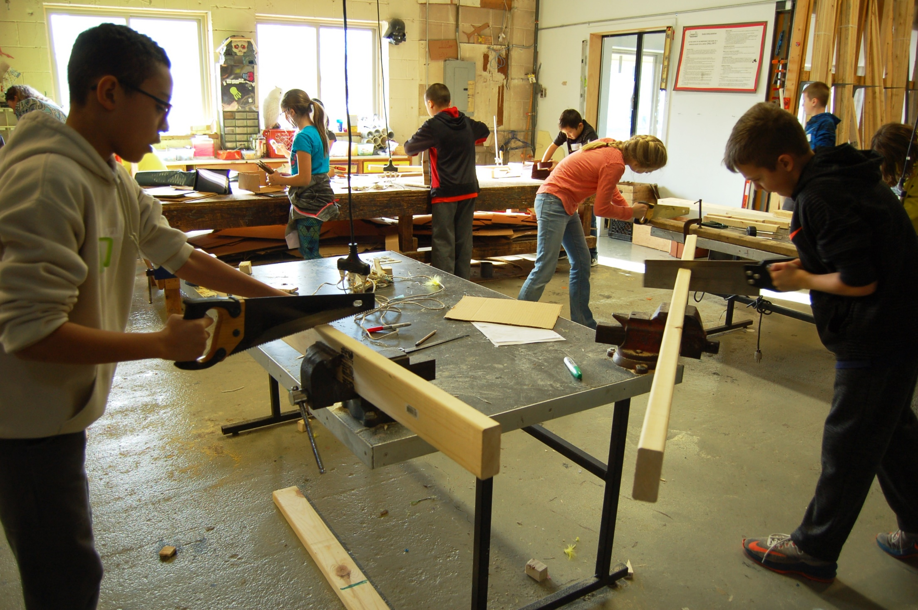
Mr Mabitso
Examinations Council of Lesoth
Mr Sekorobele Mabitso Examinations Council of Lesotho

Slide 2
Theme: Quality Assessment in an era of Educational Reforms
Sub-theme: Using learner performance for accountability purposes. Implications for teaching learning and awarding decisions.

Slide 3
Topic
Striking a balance between accountability and practical skills development in Design and Technology in Senior Secondary schools.

Slide 4
Introduction
Ever increasing levels of unemployment.
Need to have a responsive curriculum.
Technical and Vocational Education (TVET) key in addressing this challenge, of which Design and Technology is part.
Hampton (2002) defines practical skills as skills performed by hand or with human intervention using equipment, tools or technology requiring guidance, force or movement.
Design and Technology develops appropriate technical skills to enable the production of tangible solutions to design problems using a range of materials and appropriate technical and manipulative skills.
Design and technology had its own challenges.
Increasingly low mastery of practical skills.

Slide 5
Introduction (continued)
Examination is one of the ways schools communicate their achievements to stakeholders.

Slide 6
Statement of the problem
Increasingly low mastery of practical skills
Possibly due to varied reasons specific to each school.
No significant decline in the general results.
Possible there are strategies teachers use to yield good results despite declining practical skills.

Slide 7
Research Questions
1. How do teachers help learners develop manipulative/ practical skills?
2. What could be the effect of examinations on the skill development endeavors in schools?

Slide 8
Purpose of the study
explore what teachers seem to be doing right that warrants the results.
determine whether there is a possibility that teachers are guiding learners with major focus on the requirements of the examination
interrogate how teachers mitigate the effects of problems in their respective schools and stay accountable to stakeholders

Slide 9
Literature review
Design and Technology is characterized by among others use of tools and materials, proper handling and use of tools and materials, as well as procedural performance of practical tasks in a safe manner (MoET, 2016).
Learning practical skills is often through demonstration.
However, Wulf, Shea and Lewthwaite (2010) mention that although observational practice is important for learning motor skills it is typically not as effective as physical practice.

Slide 10
Literature review(continued)
Learning manipulative skills
Tenison & Anderson (2015) refer to Fitts and Posner’s three staged model of skill acquisition.
Cognitive stage
Learning theories about working procedures, safe working practices, general use of tools and materials.
Associative stage
Learners lead by the teacher through demonstrations to accomplish a task. Leaners learn the ‘how’ part through hands –on activities
Autonomous stage
Open to each learner’s creativity, learners can demonstrate and apply learned skills to new unique situations by producing tangible items

Slide 11
Literature Review (continued)
Examination as a tool for accountability
Scramble for learners within and across schools.
Examination results important in attracting more learners into the schools and subjects. attracts more learners.
Examination results according to Mofor, Awa & NguFoncha (2017) provide institutional accountability, outcomes-based education and use by parents to make choices between schools.
Examination results may exert undue pressure on candidates to out-perform their predecessors.

Slide 12
Findings
Too much theory to cover.
Large classrooms, lack of resources,
Lack of resources leading to lack of practice to a point where learners
first work when they work on their examination projects.
Simplified projects with minimal skills
School principals supply most items requested by the teacher if it is in the name of examinations.
Dissatisfaction on the contribution of practical project.
Overwhelming support for examinations.

Slide 13
Conclusion
The cost of practical subjects is becoming unbearable for most schools.
Puts pressure on teachers to seek any measure that could help learners get good results.
Society has not lowered expectations on the success of learners.
Training is needed for teachers on how to get the best of the meagre resources.

Slide 14
Recommendations
The Ministry of Education and Training (MoET) should help schools equip the workshops with the necessary equipment.
Train teachers on the best use of limited resources to reduce the cost of running the workshops.
Teachers have to involve learners in working in maintenance projects in the school as a way of expanding practice opportunities.

Slide 15
The end
Thank you

